Slide 1
Seismic Resolution
Vertical Resolution
Resolution vs. Detection
Thin Bed Response and Tuning
Lateral Resolution
Fresnel Zone
Migration and Lateral Resolution
Scenario Modeling
Gassmann Fluid Substitution

Slide 2
Detection vs. Resolution - Analogy
You are driving at night.
You spot a light in the distance.
Is it a car or a motorcycle???
Aha, it is a car!
Schroeder (2004) Courtesy of ExxonMobil

Slide 3
Resolution vs. Detection
Detection: Ability to identify that some feature exists
Resolution: Ability to distinguish two features from one another
Detection limit is always smaller than the resolution limit
Detection limit depends upon Signal-to-Noise, impedance contrast
Schroeder (2004) Courtesy of ExxonMobil

Slide 4

Vertical Resolution
Gamma Ray
What is the minimum vertical distance between two subsurface features such that we can tell them apart seismically?
Shale
Baseline
Shale
For Example:
Based on seismic data, could you determine that there is a thin shale layer between the two sands?
Sd
Sand
Schroeder (2004) Courtesy of ExxonMobil

Slide 5
Thick Bed Response
Impedance
R. C.
Wavelet 1
Wavelet 2
Composite
A
Top of Bed
Response
λ_{t}
B
NO
Interference
C
Base of Bed
Response
λ_{d} = λ_{t}*V_{int}
A thick bed is one that has a thickness > λ_{d}/2
Schroeder (2004) Courtesy of ExxonMobil

Slide 6
Partial Interference
Impedance
R. C.
Wavelet 1
Wavelet 2
Composite
A
Top of Bed
Response
B
λ_{t}
Some
Interference
Some
Interference
C
Base of Bed
Response
Thickness ~ 0.45* λ_{d}
2nd half-cycle from Wavelet 1
and 1st half-cycle from Wavelet 2
form a trough doublet
Schroeder (2004) Courtesy of ExxonMobil

Slide 7
Maximum Constructive Interference - Tuning
Impedance
R. C.
Wavelet 1
Wavelet 2
Composite
A
Top of Bed
Response
B
λ_{t}
Maximum
Interference
C
Base of Bed
Response
Thickness ~ λ_{d} /4 to λ_{d} /6
2nd half-cycle from Wavelet 1 and 1st half-cycle from Wavelet 2 are completely in phase
resulting in 2x amplitude
Schroeder (2004) Courtesy of ExxonMobil

Slide 8
Destructive Interference – Below Tuning
Impedance
R. C.
Wavelet 1
Wavelet 2
Composite
A
Top of Bed
Response
B
λ_{t}
Destructive
Interference
C
Base of Bed
Response
Thickness = λ_{d} /16
Wavelets destructively interfere. Arrival times don’t change but amplitude does
Schroeder (2004) Courtesy of ExxonMobil

Slide 9

Determining Vertical Resolution
Input Parameters:
Velocity at the zone of interest
Peak Frequency of the wavelet at the zone of interest
Pulse
Period
(ms)
Computations:
Period ~ 1/Peak Frequency
Wavelength λ_{d} = Period * Velocity
Limit of Vertical Resolution ~ Wavelength λ_{d} /4
wavelength =
period X velocity
Schroeder (2004) Courtesy of ExxonMobil

Slide 10
Typical Vertical Resolution
Shallow Event
Velocity = 2000 m/s
Wavelet: Center Frequency = 50 Hz
Period = 1 / 50 = .020 sec = 20 ms
Wavelength = .020 x 2000 = 40 m
Limit of resolution ~ 40 /4 = 10 m
As depth increases:
Deep Event
Velocity = 3000 m/s
Wavelet: Center Frequency = 20 Hz
Period = 1 / 20 = .050 sec = 50 ms
Wavelength = .050 x 3000 = 150 m
Limit of resolution = 150 / 4 = 37.5 m
Frequency
Velocity
Schroeder (2004) Courtesy of ExxonMobil

Slide 11
Summary: Vertical Resolution
Resolution is the ability to distinguish distinct events
Thin bed response occurs below tuning thickness
Short-duration seismic pulses are preferred
Broad bandwidth, zero-phase pulses are best
Pulses with minimal side-lobe energy enhance interpretability
To Improve Resolution
Bandwidth can be increased by deconvolution
Frequencies to be included must have adequate S/N
Schroeder (2004) Courtesy of ExxonMobil

Slide 12
Seismic Resolution
Vertical Resolution
Resolution vs. Detection
Thin Bed Response and Tuning
Lateral Resolution
Fresnel Zone
Migration and Lateral Resolution
Scenario Modeling
Gassmann Fluid Substitution

Slide 13
What Is Lateral Resolution?
Would we image the narrow horst?
Would we image all three channel sands?
Schroeder (2004) Courtesy of ExxonMobil

Slide 14
Lateral Resolution
What is the minimum horizontal distance between two subsurface features such that we can tell them apart seismically?
Neidell & Poggiaglioimi (1977)

Slide 15
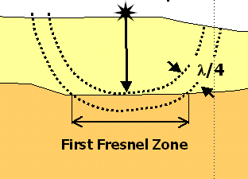
The Fresnel Zone
An event observed at a detector is reflected from a zone of points
The raypaths from source to detector which differ in length by less than a quarter wavelength can interfere constructively
The portion of the reflector from which they add constructively is the Fresnel zone
Changes that occur within this zone are difficult to resolve
The size of the Fresnel zone depends upon the length and shape of the wavelet and the depth of the reflector
Schroeder (2004) Courtesy of ExxonMobil

Slide 16
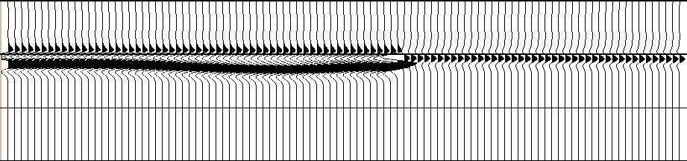
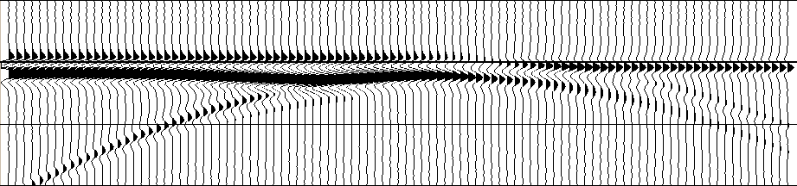
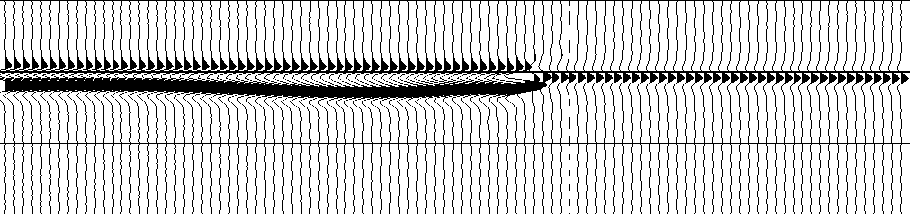
Migration Reduces Lateral Smearing
Ideal / Model
Response
800 m
Stack
No Migration
Image After
Migration
Schroeder (2004) Courtesy of ExxonMobil

Slide 17
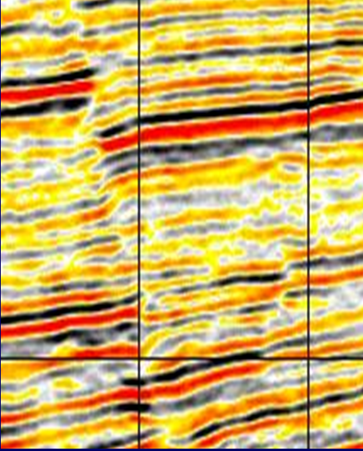
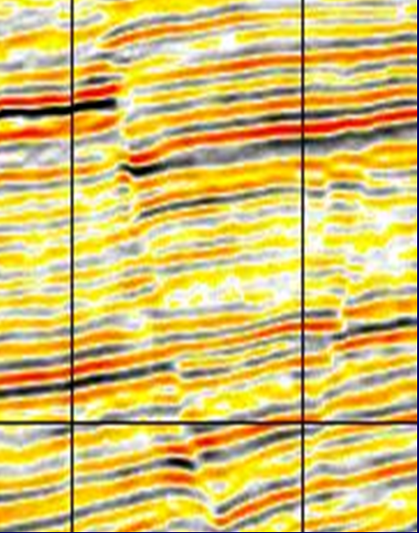
Good Migration Enhances Resolution
Standard Migration
High-end Migration
Schroeder (2004) Courtesy of ExxonMobil

Slide 18
Fresnel Zone Equations
Pre-Migration
Post-Migration
F_{d} = V_{avg} T/F
F_{d} = λ_{d} /4 = V_{avg} /4 F
where:
F_{d} = Fresnel Diameter
V_{avg} = Average Velocity
T = Time
F = Frequency of Pulse
λ_{d} = Wavelength
Schroeder (2004) Courtesy of ExxonMobil

Slide 19
Typical Lateral Resolution
Shallow Event
Time = 1.0 s
V_{int} = V_{avg} = 2000 m/s
Wavelet = 50 Hz
PreMig Fresnel Diameter = 282 m
PostMig Fresnel Diameter = 10 m
Deep Event
Time = 5.0 s
V_{int} = 4600 m/s
V_{avg} = 3800 m/s
Wavelet = 20 Hz
PreMig Fresnel Diameter = 1900 m
PostMig Fresnel Diameter = 47.5 m
Schroeder (2004) Courtesy of ExxonMobil

Slide 20
Fresnel Zone Circles
Shallow Window
282 m pre-migration
10 m post-migration
Deep Window
1900 m pre-migration
47.5 m post-migration
1 km
Schroeder (2004) Courtesy of ExxonMobil

Slide 21
Summary: Lateral Resolution
Migration enhances lateral resolution
Large aperture (receiver cable length) is needed for high lateral resolution
Fine spatial sampling is needed for high lateral resolution
Prestack migration provides better lateral resolution than post stack migration
Depth migration provides better resolution than time migration
Schroeder (2004) Courtesy of ExxonMobil

Slide 22
Seismic Resolution
Vertical Resolution
Resolution vs. Detection
Thin Bed Response and Tuning
Lateral Resolution
Fresnel Zone
Migration and Lateral Resolution
Scenario Modeling
Gassmann Fluid Substitution

Slide 23
Scenario Modeling - Pitfalls
Always be sure that the rocks you’re interested in tie to the attribute your measuring!
Low
impedance
sand
Low
impedance
shale
High
impedance
sand

Slide 24
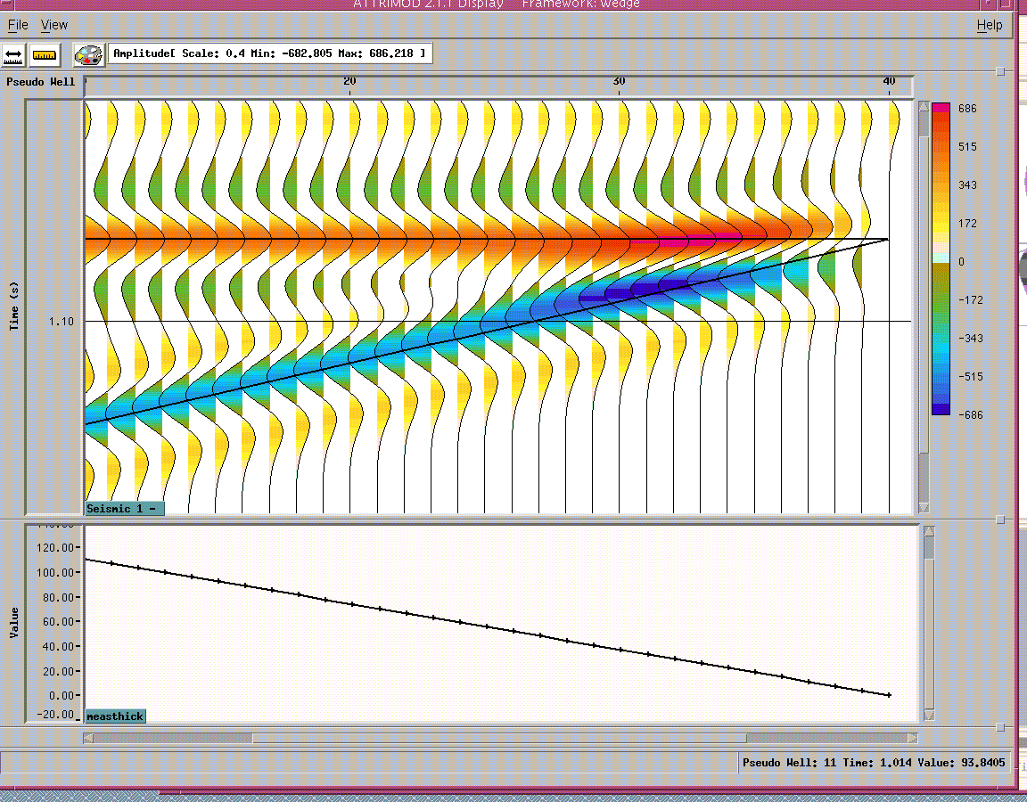
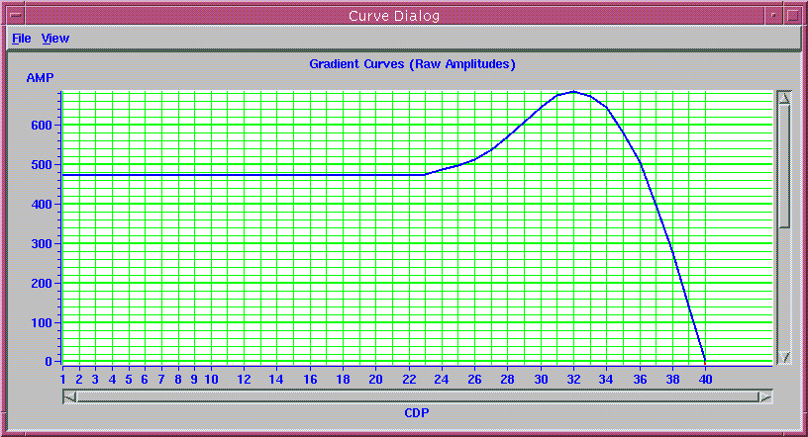
Scenario Modeling - Thickness vs. Seismic Amplitude
360’
125’
0’
Wedge Model
(20 Hz Ricker - 10000 f/s)
Period = 1 / 20 = .050 sec
λ_{d} = .050 x 10000 = 500 ft
∼ λ_{d} /4
Amplitude of Top Reflection
Notes:
What we care about is how different are the properties of hydrocarbons and water. The greater the difference, the greater the change in reflection amplitude.
EXPLAIN SLIDE

Slide 25
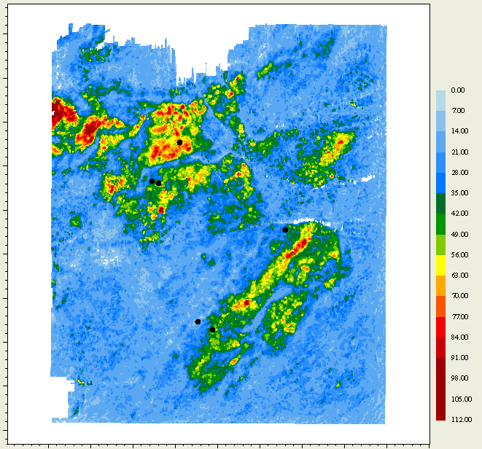

Can I Predict Reservoir Presence?
Net Sand Predicted from Amplitude
Well B
71’
Well B
Well E
Well C
Well F
Well D
15’
Well D
Well A
Well
Net Sand
Pred.
Well B
71
68
Well E
21
29
Well C
48
42
Well A
62
53
Well D
15
14
Well F
44
36

Slide 26
Seismic Resolution
Vertical Resolution
Resolution vs. Detection
Thin Bed Response and Tuning
Lateral Resolution
Fresnel Zone
Migration and Lateral Resolution
Scenario Modeling
Gassmann Fluid Substitution

Slide 27
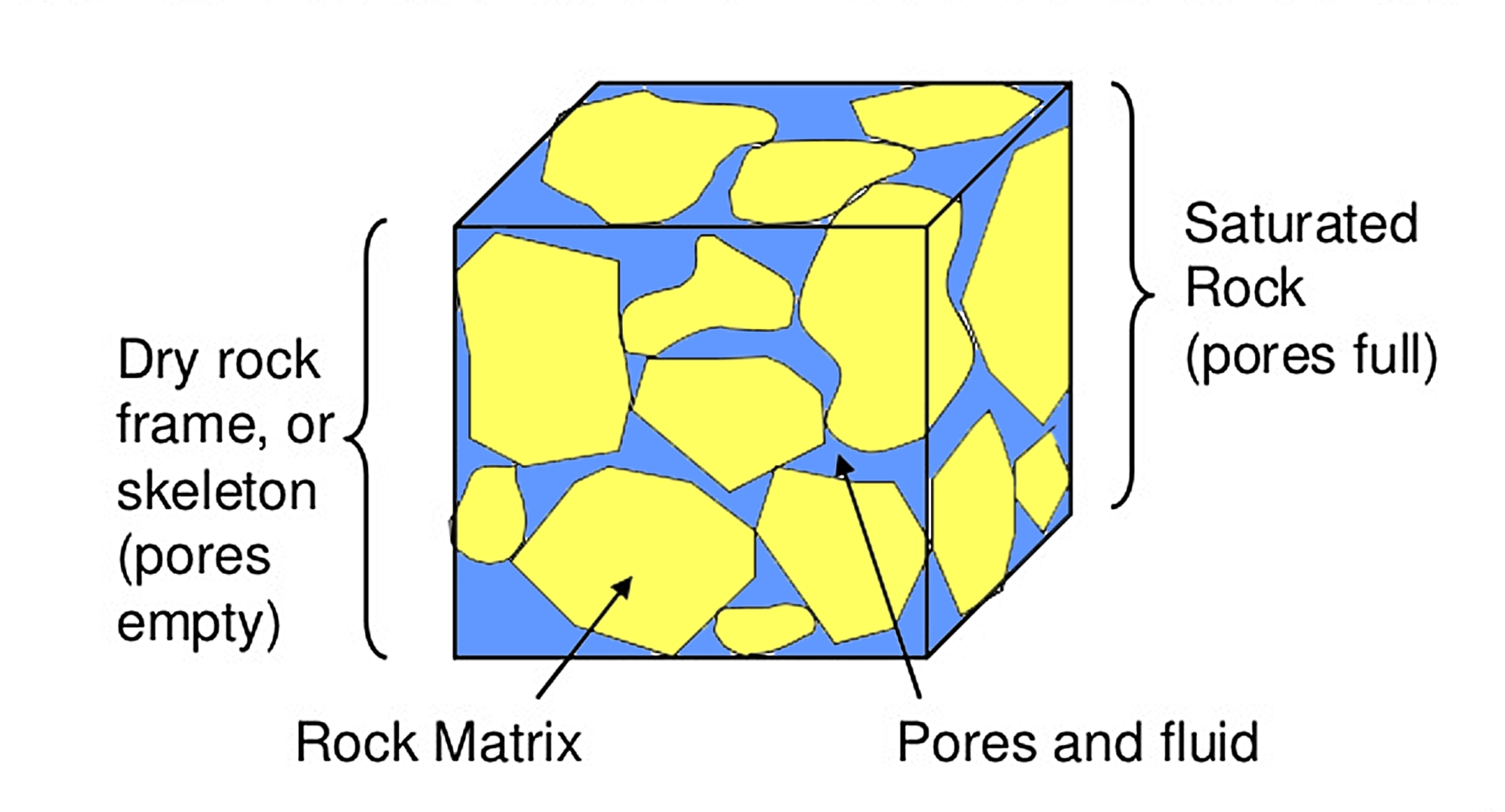
Fluid Substitution - Biot-Gassmann Equations
The existing rock
Russell (2015).

Slide 28
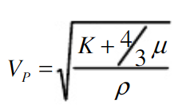
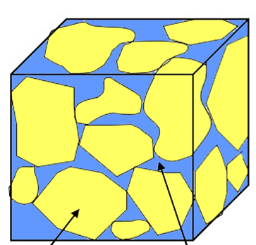
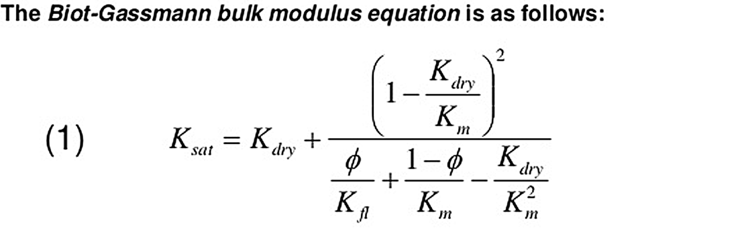
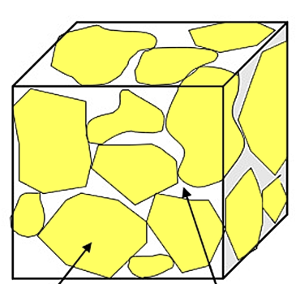
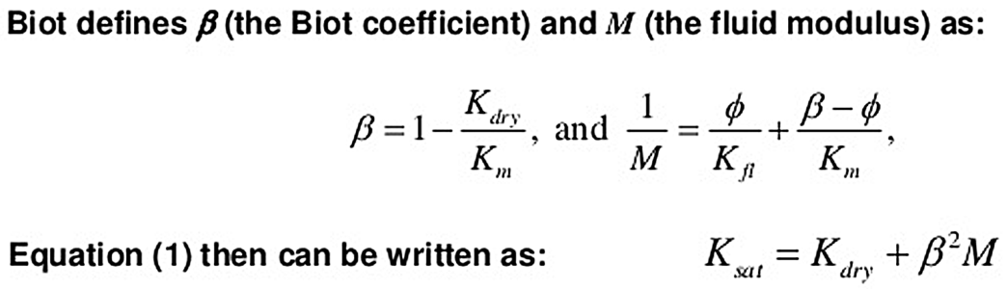
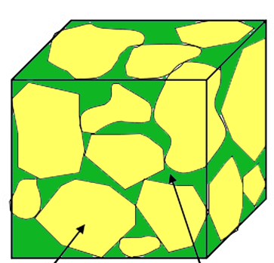
Fluid Substitution - Biot-Gassmann Equations
K - Bulk Modulus
µ - Shear Modulus
ρ - Density
Reservoir Conditions
Dry Framework
Fluid Substitution
ρ_{dry} = ρ_{sat} - φ * ρ_{fl(g,o,w)}
υ_{dry} = υ_{sat}
Dry Rock Shear Modulus Does Not Change
Russell (2015).

Slide 29
Scenario Modeling – Fluid Substitution
 | Velocity | Density | Imped
Overburden | 2500 | 2.30 | 5750
Oil Sand | 2250 | 2.03 | 4570
Swept Sand* | 2454 | 2.14 | 5240
Water Sand | 2673 | 2.15 | 5740
Underburden | 2250 | 2.23 | 5020
 | * Swept sand has 10% residual oil
Original Reservoir Conditions
Oil Over Water
100m Oil Production
Oil Replaced by Water
5750
5020
5750
5020
-0.11
-0.02
0.68
.046
-0.11 0.00
0.05 -0.67
0.11
4570 5740
4570 5240 5740

Slide 30
Scenario Modeling – Fluid Substitution

Slide 31
References
Pant, D. R., & Greenhalgh, S. A. (1989). Lateral Resolution in Seismic Reflection-A Physical Model Study. Geophysical Journal International, 97(2), 187–198. https://doi.org/10.1111/j.1365-246X.1989.tb00495.x
Russell, B. (2015). AVO and Inversion -Part 1 Introduction and Rock Physics. http://muhendislik.istanbul.edu.tr/jeofizik/wp-content/uploads/2015/04/Dr.-Brain-Russell-Lecture-Part-1.pdf

Slide 32
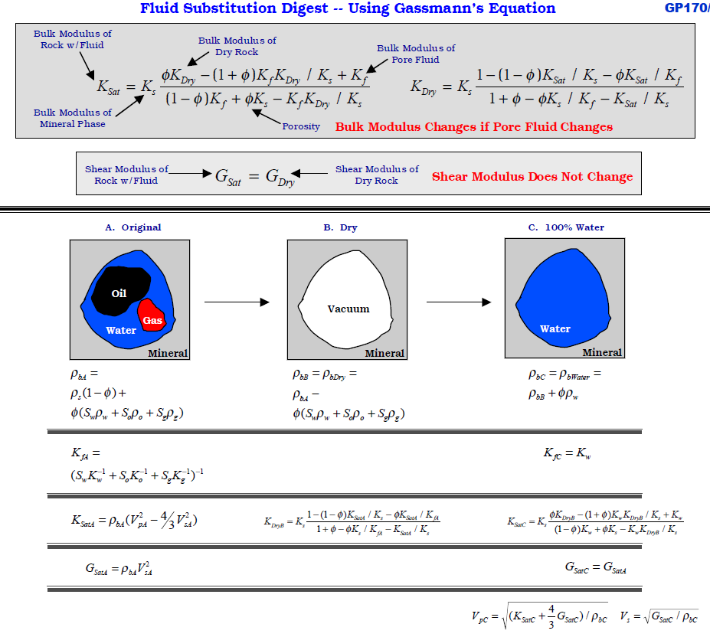
Fluid Substitution Using Gassmann’s Equations

